Slide 1
TVS Credit Loan Default
About Business Problem
Objective
Identified business problem.
Problem solving with Python & Excel.
Problem Visualization.
Data Source :- Kaggle
Data Link:- https://www.kaggle.com/datasets/sjleshrac/tvs-loan-default

Slide 2
TVS Credit Loan Default
Problem Statement
TVS Credit facing loan default issue with their customers.
As a Business/Data Analyst we have to find out what are factors responsible for defaulting loan.
We have data TVS Credit dataset for analyzing the problem.
Our motto is to find out the reason behind defaulting loan and protect business loss.

Slide 3
TVS Credit Loan Default
Data Overview
We have 119528 customer’s data with 32 Columns.
In Data we have null values.
Firstly we have to clean our data so that our can find right key factors.
We have to do some EDA and Visualization.

Slide 4
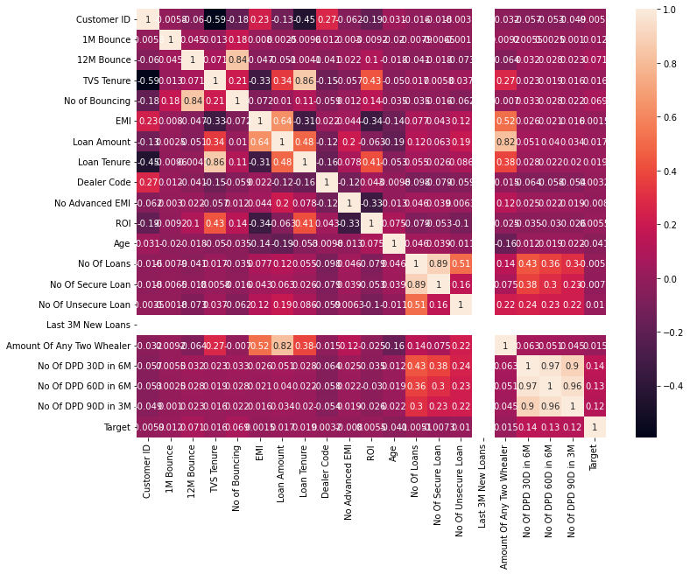
TVS Credit Loan Default
Exploratory Data Analysis
Through the heatmap we can see that which feature correlated with target variable

Slide 5
TVS Credit Loan Default
Exploratory Data Analysis
We did some EDA then we found that Data having null values, Outliers and right skewed.
Then we found that there are 5 columns having more than 68% null value and with no correlation so we can directly drop these 5 columns.
After dropping 5 columns we have 27 columns with 119528 rows.

Slide 6
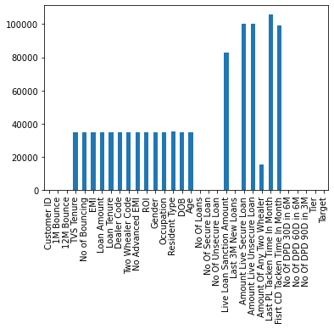
TVS Credit Loan Default
Exploratory Data Analysis
This bar graph represent that
we have 5 columns that having
null values more than 68% and after
dropping we have 27 columns.
Data | Actual Data | After EDA
Rows | 119528 | 119528
Columns | 32 | 27

Slide 7
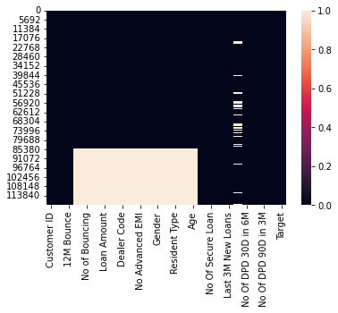
TVS Credit Loan Default
Exploratory Data Analysis
We have null values present in our data set .
White spot represent null values.
Null value is more than 10% then we can apply business rule to fill null value or we can drop the features.
It totally depend on business rule.
As of now we are leaving these features as it is.

Slide 8
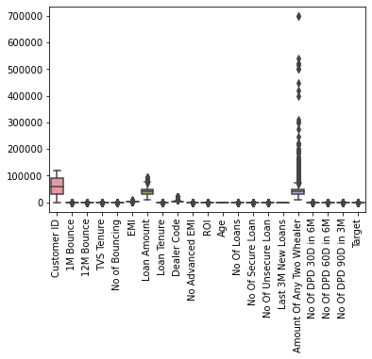
TVS Credit Loan Default
Exploratory Data Analysis
Now we can see the Outliers and if we want to fill null values then we have to go according to the business rule.
Also we can replace null values with median/mode.

Slide 9
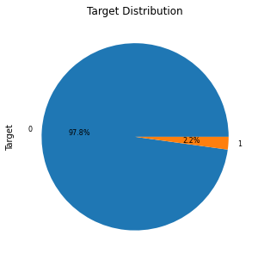
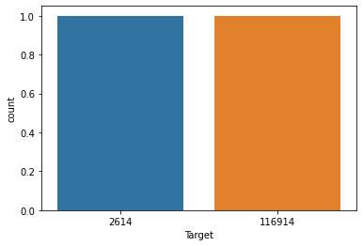
TVS Credit Loan Default
Exploratory Data Analysis
Our 2.2% customer is defaulter.
Now we cave to find these 2.2% defaulter why defaulting Loan.
We have defaulter’s count 2614 and 116914 non defaulter’s

Slide 10
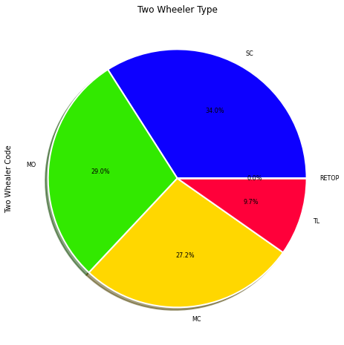
TVS Credit Loan Default
Exploratory Data Analysis
Customer’s percentage having two wheelers type.
There are customer having 34% Scooter and then Very few Having 9% Tvs Loona.

Slide 11
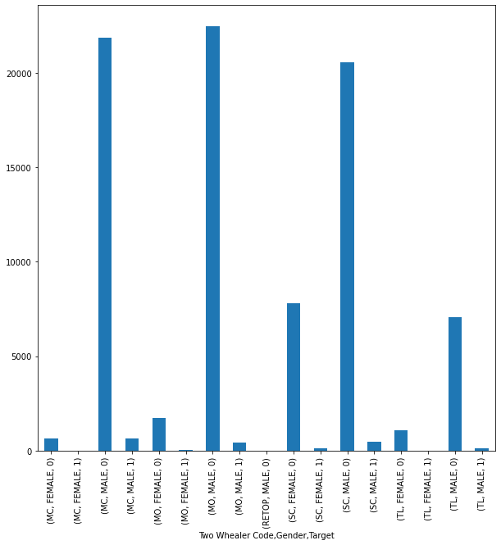
TVS Credit Loan Default
Exploratory Data Analysis
Through the bar chart we can see that maximum male having MC,MO,SC defaulting loan and female having TL not defaulting Loan.
We can see the pattern of customer with having Two wheeler gender wise defaulting loan or not.
If customer buying MC,SC we have to be careful.

Slide 12
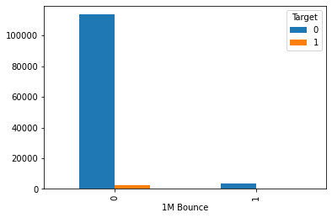
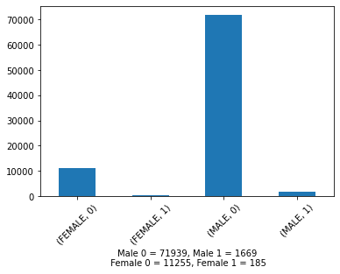
TVS Credit Loan Default
Exploratory Data Analysis
This chart represent that very few women’s defaulting loan in very first month

Slide 13
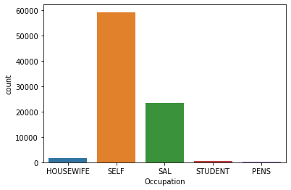
TVS Credit Loan Default
Exploratory Data Analysis
Majority of people having their own business.
There are some students and pensioners.
Maximum males belongs Tier 4.

Slide 14
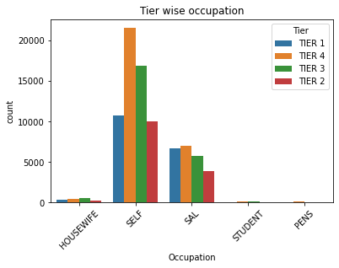
TVS Credit Loan Default
Exploratory Data Analysis
Male who belong to Tier 2 and Tier 4 defaulting more Emi’s.
It could be due to high number of population belong to Tier 2 and Tier 4.
Also Salaried people percentage high defaulting loan.

Slide 15
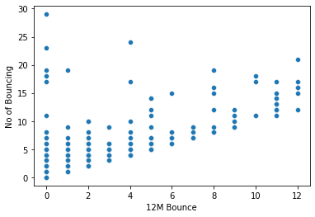
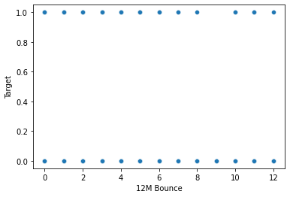
TVS Credit Loan Default
Exploratory Data Analysis
Now we can see that maximum Emi’s bouncing in Jan month and very less Emi’s bounce in July month & no bouncing in September.
We are getting high loss in January month.
Monthly EMI Trend for whole Year.

Slide 16
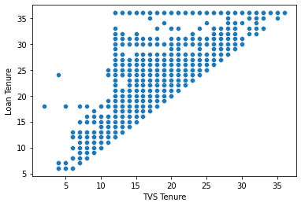
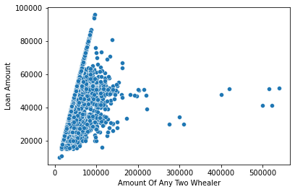
TVS Credit Loan Default
Exploratory Data Analysis
Now we can find that range of loan amount approval is 15k to 65k.
But there are few customer who get approval of Rs. 95k.
Range of loan tenure is 12 to 18 month. And few got 36 month.

Slide 17
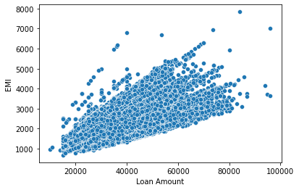
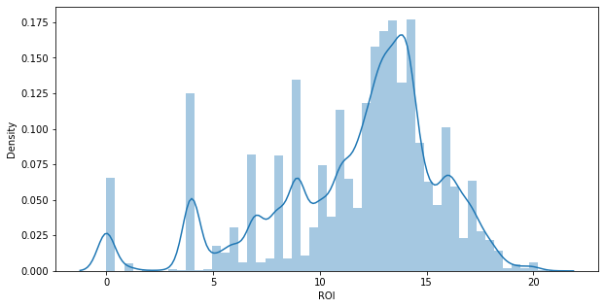
TVS Credit Loan Default
Exploratory Data Analysis
Now maximum ROI is 16% for 12 to 15 months.
Average EMI amount is Rs. 2500 to 4000
Few customers getting approval of Rs. 95k and EMI of Rs. 7600.

Slide 18
TVS Credit Loan Default
Exploratory Data Analysis
There are some high aged customer who are defaulting loan.
Eg. People who crossed 60+ they are defaulting loan.
Also Tier 3 is fine so we can more focused on Tier 3.

Slide 19
TVS Credit Loan Default
Conclusion & Business Advise
Total customers are 2.2% who defaulting loan we have to identify what is the reason for defaulting loan.
Females loan defaulting ratio very low so if female asking for loan for buying TL we can give on less documentation.
If male buying MC,SC then we have to do strong background check because customer who bought MC,SC defaulting loan.
If customer is salaried or having business and belong to Tier2, Tier4 then again strong background check required because their loan defaulting ratio is high.
Maximum Emi’s bounce in January month so that we can run some cam campaign or we can give offer to the customer in Jan month.
If customer asking loan for long time then again strong background check required.
We can approach to the student because they are not defaulting loan.
There are some cases like if customer’s age more than 55 year then defaulting chance of the loan increasing.

Slide 20
TVS Credit Loan Default
End
Thank You. ☺

